Slide 1


PhonePe Case Study

Slide 2

Today's agenda
Project Recap
Project Objective
Process
Data Overview
Data Cleaning & Preprocessing
High Level Statistics
Insights

Slide 3

This case study involves analyzing transaction data from the financial application PhonePe along with demographic data across various states and districts in India. The datasets span multiple years and quarters, providing a comprehensive view of transactions, user behavior, and demographic details.
Project Recap

Slide 4


Project Objective
The objective is to provide insights into transaction trends, device usage, and demographic correlations, while ensuring data consistency and performing advanced analyses to uncover deeper insights.
Tools: Python (Pandas, Matplotlib, Seaborn, Scikit-learn)

Slide 5

Process
1
Data Collection
2
Data Understanding
3
Data Cleaning
4
Data Visualization
5
Uncover Insights

Slide 6
Data Overview
Data Source:
Phone Pe Dataset
Key Dataset Used:
5 Datasets used
State_Txn and Users
State_TxnSplit
State_DeviceData
District_Txn and Users
District Demographics
Covered aspects:
Transactions, user count, device brands, district demographics.

Slide 7

Data Cleaning & Preprocessing
Handled Missing Values
Identified missing values across datasets using .isnull().sum().
Filled missing numerical fields like 'Amount (INR)' and 'ATV (INR)' with 0 to avoid impact on aggregation.
Categorical missing values in columns like 'Code' were replaced with "Unknown" to maintain consistency.
Dataset Consolidation
Vertically combined all 5 datasets using:
This unified all data into a single master DataFrame to simplify overall analysis and visualization.
Used ignore_index=True to reset indexing after merging.
Data Type and Format Corrections
Ensured date-related columns were properly formatted.
Verified numerical fields were correctly typed (int, float) to enable arithmetic operations.

Slide 8


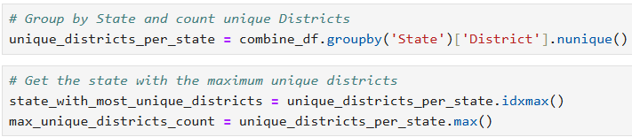
High Level Statistics
Total Number of States & Districts
Extracted unique states from state-level datasets using:
Total States: 36
Counted distinct districts from district-level datasets using:
Total Districts: 836
State with the Most Districts
Grouped by 'State' and counted unique districts and then count maximum unique districts:
State with Highest Number of Districts: Uttar Pradesh (83 Districts)

Slide 9
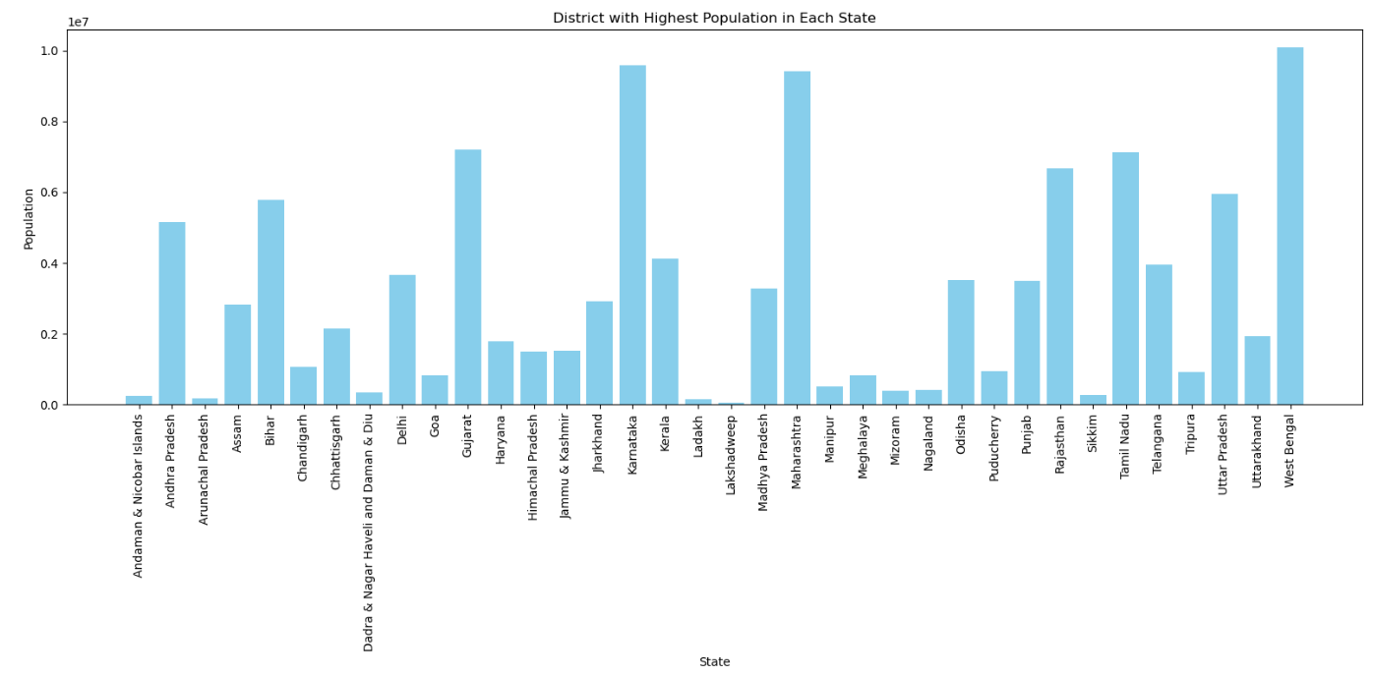
Insights
District with Highest Population in Each State
West Bengal has the district with the highest population among all states
Other states with highly populated districts include Karnataka, Maharashtra, and Gujrat
Some northeastern and union territory districts have comparatively lower populations, reflecting demographic variations
This analysis tells us which areas have more people and higher digital payment use

Slide 10
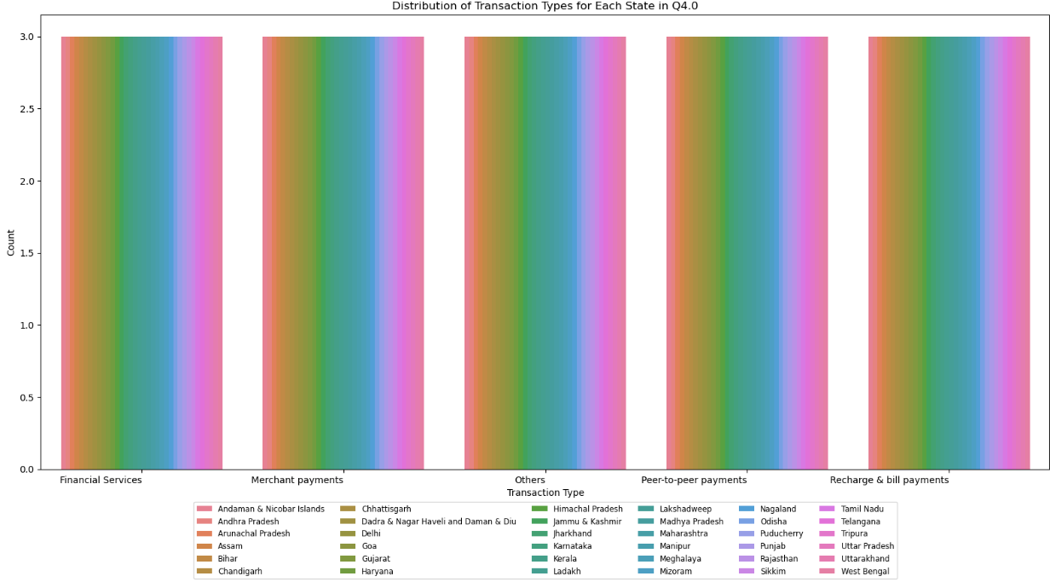
Transaction Type Distribution – Q4
The bar chart shows how different transaction types are distributed across each Indian state/UT in the most recent quarter (Q4)
All states are contributing to all 5 transaction categories, indicating a pan-India digital adoption across services
No single transaction type is limited to a specific state or region. This suggests that digital payment behaviors are becoming standardized across India

Slide 11
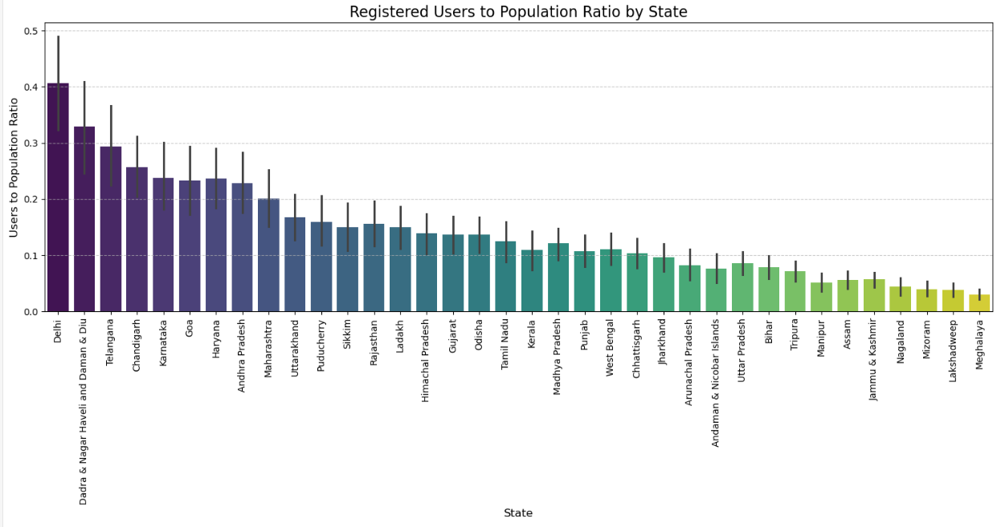
User Penetration Across States – Registered Users vs Population Ratio
Delhi has the highest user-to-population ratio, indicating strong digital adoption and likely better infrastructure, awareness, and urban population
Smaller UTs like Dadra & Nagar Haveli and Daman & Diu also show high ratios, possibly due to concentrated population and effective digital outreach
Northeast and rural states like Meghalaya, Mizoram, Nagaland, and Assam show relatively lower ratios, suggesting scope for digital expansion

Slide 12
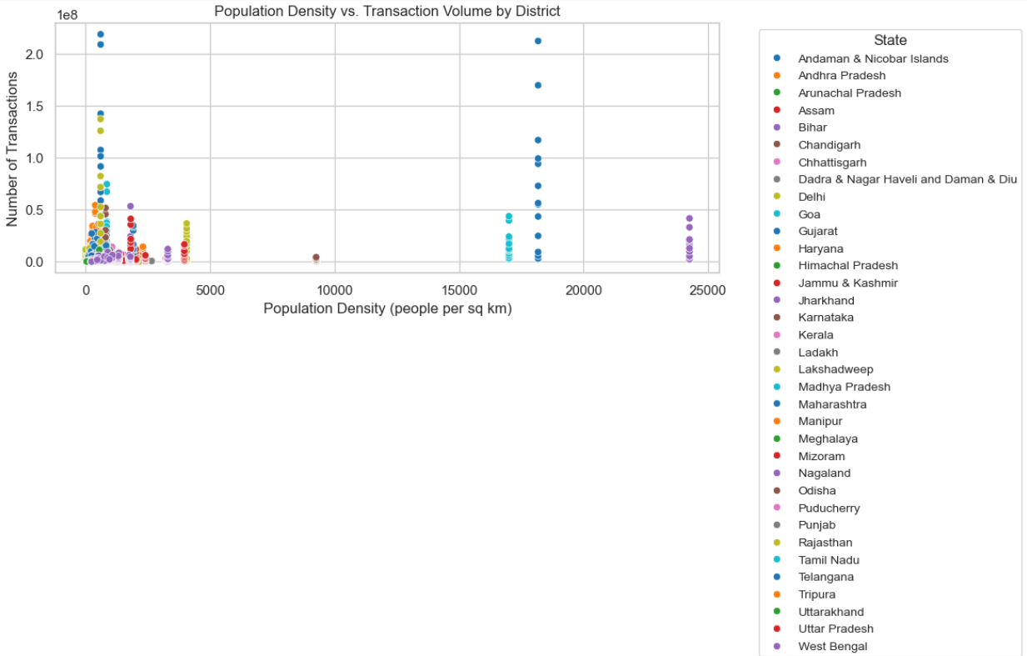
Impact of Population Density on Transaction Volume
This scatter plot shows the relationship between Population Density (X-axis) and Number of Transactions (Y-axis) across Indian districts.
Each dot represents a district and is color-coded by state.
A weak positive correlation is observed (correlation = 0.31), suggesting that more populated areas generally do more transactions - but not always.
Some districts with low population density still show high transaction volume, indicating other factors like urbanization, smartphone and internet penetration, state-level digital adoption policies

Slide 13
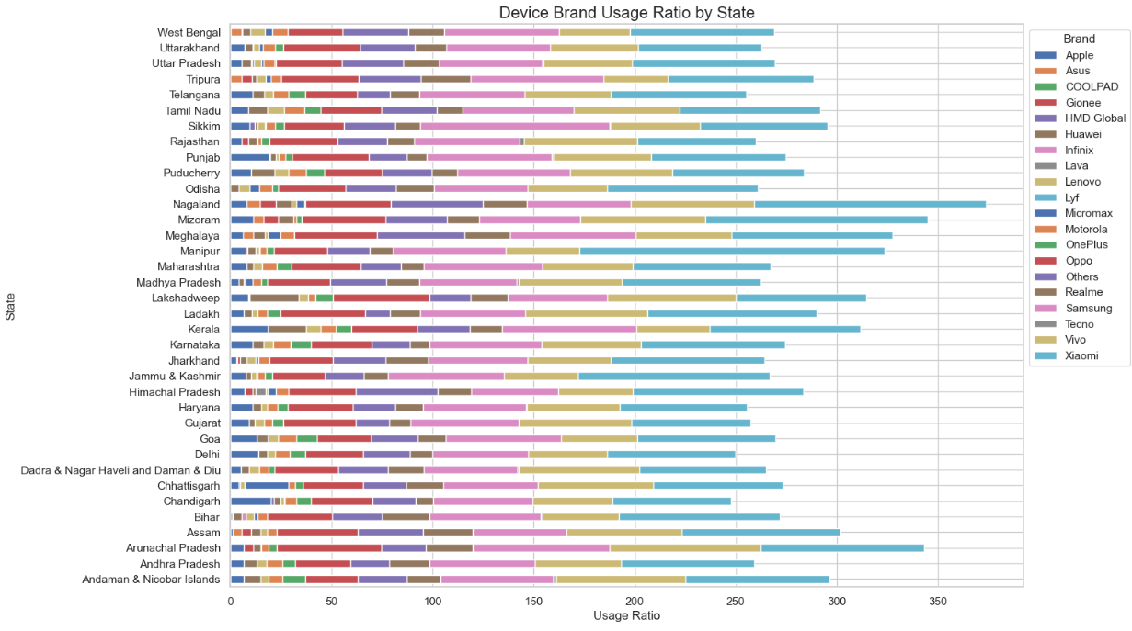

Device Brand Usage Ratio by State
Xiaomi leads in most states, indicating its popularity due to affordable pricing and strong mid-range offerings.
Samsung also shows a strong presence across nearly all states, reflecting its broad product portfolio catering to both budget and premium segments
Vivo and Oppo maintain a consistent user base in many states, likely due to aggressive marketing and offline availability
Premium brands like Apple and OnePlus have a relatively smaller footprint, concentrated more in urban or economically stronger states like Delhi, Maharashtra, and Karnataka.

Slide 14
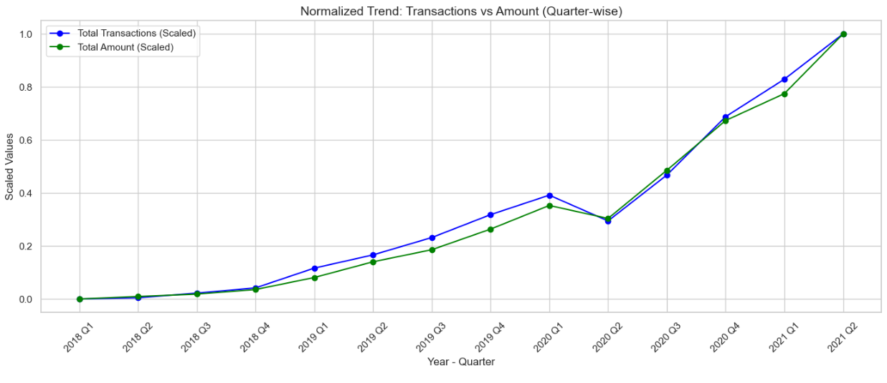
Quarter-wise Trend Analysis: Total Transactions vs Total Amount (Normalized)
Overall Growth: Both total transactions and total amount show a consistent upward trend, indicating increasing digital payment adoption over time.
Pre-2020 Growth: From 2018 to early 2020, there is steady and parallel growth in both metrics, reflecting expanding user base and transaction volume.
COVID-19 Dip (2020 Q2): A visible dip occurs in Q2 2020, likely due to the first COVID-19 lockdown, when consumer spending and digital activity reduced briefly.
Post-COVID Surge: Following the dip, both metrics rebounded strongly, with a sharp rise starting Q3 2020, driven by increased reliance on contactless/digital payments, greater internet and smartphone penetration, government and private sector push for digital finance
Q2 2021 Peak: Both scaled lines hit their maximum values in Q2 2021, indicating the highest recorded total transactions and total amount till that point.

Slide 15
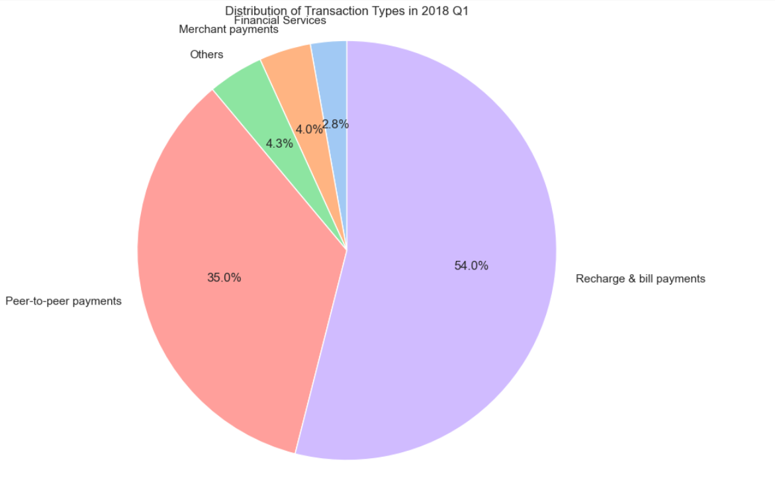
Transaction Type Distribution – Q1 2018
Recharge & Bill Payments accounted for the largest share at 54%, making it the most commonly used feature. This indicates that PhonePe initially gained popularity as a utility payment platform.
Peer-to-Peer (P2P) Payments contributed 35%, suggesting growing trust in using UPI for personal transfers.
Merchant Payments and Financial Services were still in the early stages, together making up just around 7%.
Others accounted for a minimal 4.3%, likely representing miscellaneous or less frequent use cases.

Slide 16
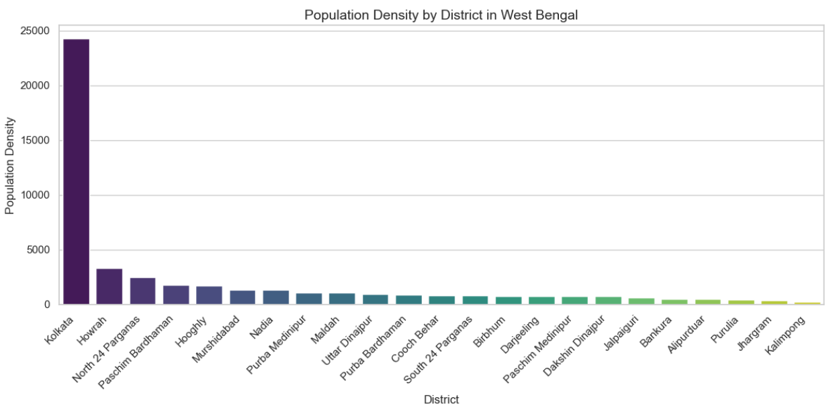
Quarter-wise Trend Analysis: Total Transactions vs Total Amount (Normalized)
Kolkata stands out with a staggering population density of ~24,000 people/km², far higher than any other district - a clear urban center.
Other high-density districts include Howrah, North 24 Parganas, and Paschim Bardhaman, indicating concentrated urban settlements.
Rural districts like Kalimpong, Jhargram, and Purulia show much lower density, reflecting less crowded, possibly less digitally active regions.
High-density districts often have more smartphone and UPI adoption.
Lower-density regions may face challenges like poor internet infrastructure, affecting digital payment penetration.

Slide 17
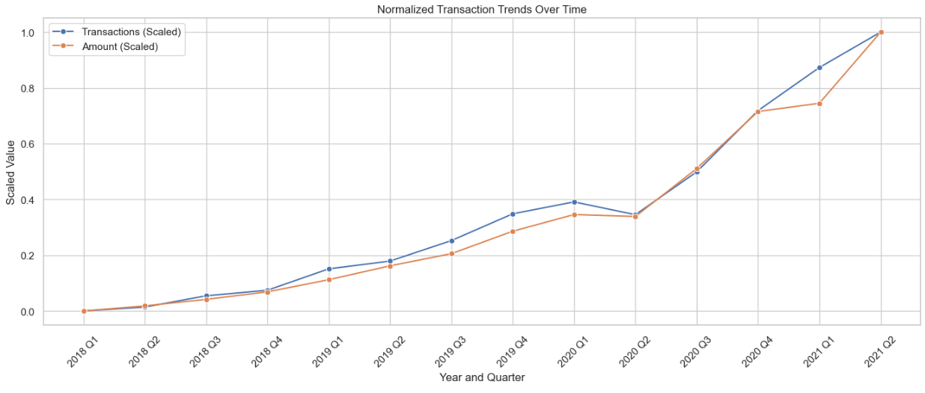
Digital Transaction Growth Over Time (2018–2021)
There is a consistent upward trend in both transaction volume and amount over time.
A small dip in 2020 Q2 likely due to COVID-19 lockdown impact.
Sharp rise from 2020 Q3 onwards, indicating strong post-pandemic recovery and accelerated digital adoption.
By 2021 Q2, both metrics peaked - showing maximum digital payment activity in the period.

Slide 18
Thank you!
ANY QUESTIONS?

